Slide 1
Notes for Teachers
Use this PowerPoint to reinforce fact-checking and becoming informed before voting.
Encourage students to research candidates and issues on the ballot even if they are not eligible to vote.
Prompt students to explore the websites included in this PowerPoint(slides 10 and 12) and become more aware of political issues in the United States, Virginia, and Fairfax County.

Slide 2
100 Year Mission To:
Empower Voters
Defend Democracy
Notes:
Welcome to this presentation by the League of Women Voters. Shortly after the 19th amendment was passed and women received the right to vote, the League of Women Voters was established to assist people to register to vote and provide nonpartisan information so that people could become educated voters. Your vote is a powerful tool and should be used wisely. Voting is one of the most important decisions you make. Your vote is your opportunity to influence local, state, and national government. The goal of this PowerPoint is to provide information so that you can become an educated and informed voter.
Image:
https://www.freepik.com/free-vector/happy-independence-day-banners_895048.htm#page=1&query=US%20patriotic%20banner&position=4

Slide 3
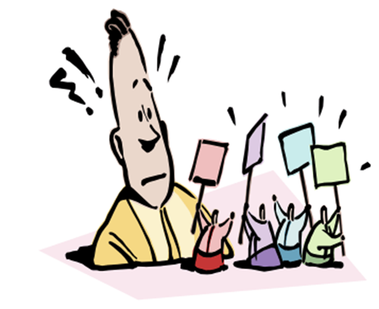
Notes:
How can you become knowledgeable about the issues and the positions of candidates? You need to do this in order to make an informed decision about which issues matter the most to you and therefore which candidate will receive your vote. Remember that there are many organizations who are trying to influence your vote.
How can you make a wise decision without being swayed by misinformation? Become an informed voter!
Images:
http://clipart-library.com/clipart/757082.htm
http://clipart-library.com/clipart/8TAkdAdTa.htm

Slide 4
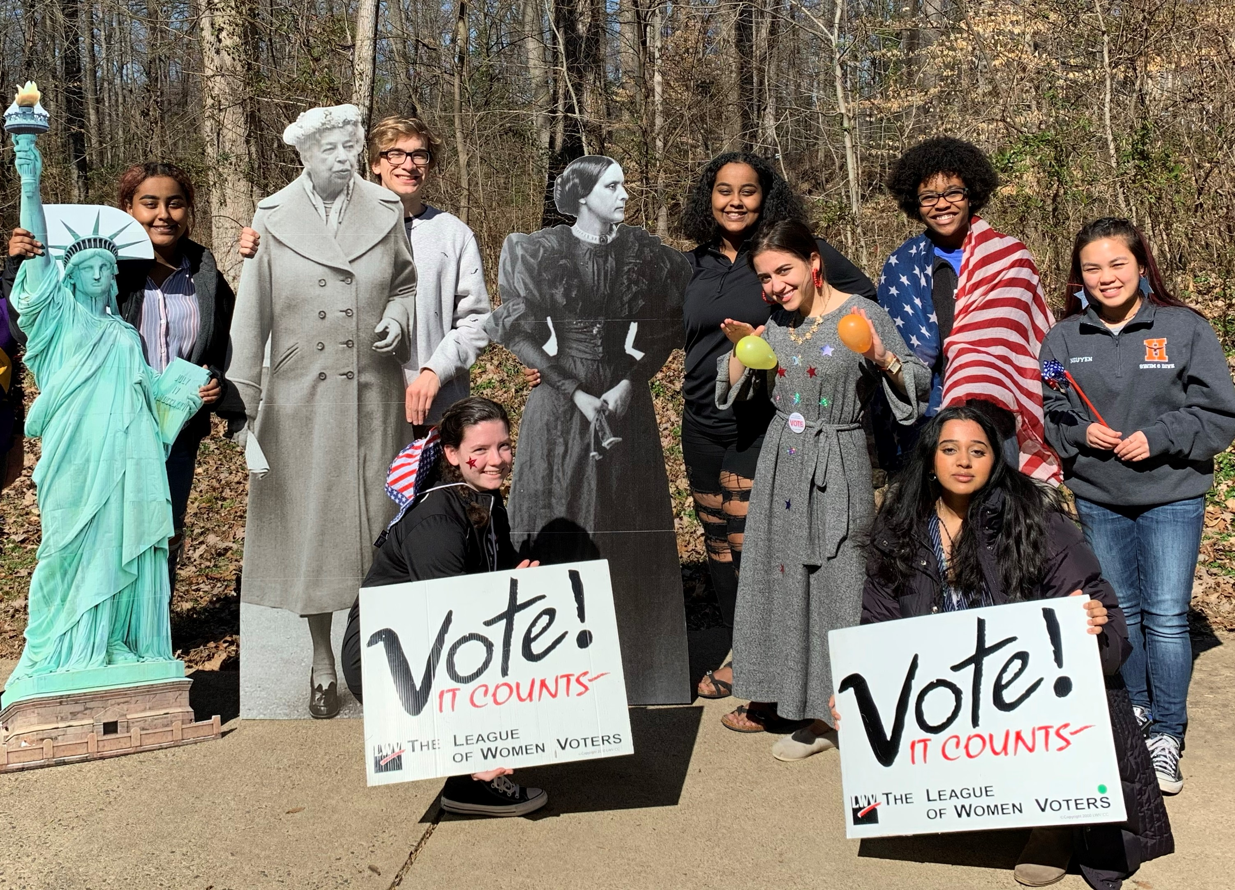
How do I become an informed voter?
Who are the candidates?
What are
the issues?
How do I make up my own mind?
How do I know if I can trust
a source of information?
Notes:
Informed voters are knowledgeable about the issues and positions of the candidates. They make decisions without undue influence from outside factors intended to persuade those who may not fully understand a candidate’s platform or ideas.
You need to make your decisions based upon accurate information, but how will you find that information? What nonpartisan resources can help inform your decisions about voting?
Image: League of Voters of the Fairfax Area

Slide 5
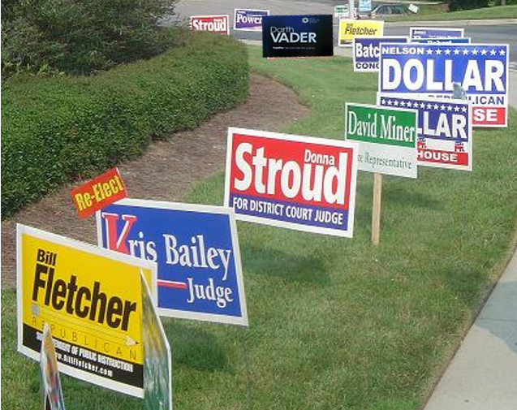
How will you decide which candidate gets your vote?
Notes:
Especially in state and local elections which affect us the most, many people are running for office and want you to vote for them. How can you decide which candidates are worthy of your vote and will represent your views and opinions? You can read information about the candidates on nonpartisan websites or listen to their ads with a critical ear.
Images:
http://clipart-library.com/vote-signs-pictures.html
Yard signs - This work has been released into the public domain by its author, Seth Ilys at English Wikipedia.

Slide 6
Analyze What You Hear, View, and Read
Stop and Think
Check the Source
Be Wary of Slogans
Become a Citizen Investigator
Notes:
Here are ways to become an informed voter. You need to analyze critically what you hear, view, and read. We’ll talk about each of these ideas.
Image:
https://www.freepik.com/free-vector/novelist-writing-concept-illustration_9148013.htm#page=1&query=thinking&position=27

Slide 7
Stop and Think
Secret agenda
Look for emotion-laden words.
Remember, words matter!
Headline Examples:
Fiery Barbs in Speech
The Dollar is Doomed
Jobs Report Exaggerates
Candidate Vows to Drain the Swamp
Right-wing
Left-wing
Tragic
Radical
Cowardly
Reactionary
Unstable
Deep State
Hot Mess
Notes:
Think about the words you encounter when listening to ads or when reading articles in print or online. Watch for “loaded” words that attempt to influence you in either a positive or negative way. These words signal a point of view and are not neutral or impartial. They are often used to appeal to emotions or stereotypes. The author is using these words to influence your thinking about an issue or a candidate.
Look at the words in the headlines. What are the “loaded” words that might show a bias in the headlines listed?

Slide 8
Check the Source Make sure that information stated as a fact IS indeed a fact.
Shootings in NYC up 25 %!
Coronavirus fatality rate for people under 45 almost ZERO
Candidate opposes anti-lynching law
How can you find out?
Find the facts using nonbiased websites, such as:
FactCheck.org
Snopes.com
Notes:
At times, articles may contain information that is stated as a fact but is not true or does not convey the whole story or the complexity of the issue. Ask yourself, where was this information obtained? Who wrote it? Is it just the writer’s opinion? Is the writer trying to influence me? Check to see if the information is true.
For example, if shooting rates go up, when did they increase? Over a month, a year, more than a year? What might have contributed to the rise?
Rates for death may be a small percentage of the entire population, but what is the number of people who perished? Could that be a significant number of people? Were the rates different for various parts of the population? Were the rates different depending on location?
A candidate might oppose a law because the law is flawed in some way. Perhaps there was something included in the law that was so objectionable, that the candidate could not endorse it. You won’t know unless you check the source of the information. These two websites, FactCheck.org and Snopes.com are non-biased websites that provide information that will help you determine the truth.
Images:
FactCheck.org website
Snopes.com website

Slide 9
Be Wary of Slogans
Where’s the Beef?
A Better Man for a Better America
A Leader for a Change
No Car Tax
Yes, We Can
A Time for Greatness
No New Taxes
A Chicken
in Every Pot
Stronger Together
Ross for Boss
Notes:
Look at these slogans. These slogans came from past political campaigns. What do they really tell you? Political slogans are catchy phrases created to appeal to voters and help one to remember with whom they are associated. They may make an emotional appeal, but they are often meaningless and do not convey factual information about the candidate. In some cases, they are empty promises that are NOT kept. Three of the slogans in the middle, “No Car Tax, No New Taxes, and A Chicken in Every Pot”, were promises that were not kept. Watch out that you are not swayed by a slogan.
(The candidates that used these slogans are listed below in case you want to share more information with students.)
A Time for Greatness (JFK)
A Leader for a Change (Jimmy Carter)
Where’s the Beef? (Mondale)
A Better Man for a Better America (DOLE)
Yes, We Can (Obama)
Stronger Together (Hillary)
No New Taxes (Bush)
No Car Tax (Gilmore-Governor of VA)
Ross for Boss (Ross Perot)

Slide 10
Become a Citizen Investigator
https://www.vote411.org/
Notes:
Investigate issues and candidates to find accurate information. Use websites that provide accurate and non-partisan information. Vote411.org is highly recommended as a credible source of information. Explore this website and view all the information it offers.
Do your research ahead of time and go to the polls prepared to vote.
Images:
Created using Microsoft Word
League of Women Voters, Vote 411.org

Slide 11
Find out what is on YOUR ballot.
Read Answers to the Same Questions from the Candidates
Notes:
On the Vote411.org site, enter your name and address, and information that is specific to the what will be on your particular ballot for the next election. You will get information about who is running for office, their answers to the questions on specific issues, when the election will be held, and other measures or questions that will be on the ballot. For example, a question on the ballot could be something such as, “Do you approve of additional bonds (borrowing and repaying gradually) to allow the expansion of parks in Fairfax County?” You can also check to make sure you are registered and locate your polling place. Vote 411.org is a nonpartisan, unbiased website that has information you need so that you can make careful and informed decisions. Check it out when you are getting ready to vote. The Voter’s Guide is a helpful tool that you can print and take to the polling place with you if you like.
Images:
Vote 411.org

Slide 12
More Reliable Sources of Information
Virginia Public Access Project (VPAP.org) provides a wealth of information about Virginia politics and voting issues.
Project Vote Smart (voteeasy.votesmart.org) supplies information about candidates for President, US House, and US Senate and their stance on specific issues.
Ballotpedia (Ballotpedia.org) provides a sample ballot based on your address.
ProCon.org (procon.org) presents non-partisan, pro/ con arguments about controversial issues.
Notes:
The Virginia Public Access Project provides nonpartisan information about political issues specific to Virginia, including campaign contributions, redistricting, work of the Virginia legislature, who is lobbying the legislators, and much more.
Project Vote Smart gets into the details with each candidate for President, House, and Senate on their stated positions, proposals, and their experience with the issues. Simply select an issue, answer a few questions about your opinion, and then learn where each candidate stands.
On Ballotpedia, you can see not just the major candidates on your ballot, but the local propositions and smaller local offices like sheriffs and judges. You can even find information on who is running for a seat on the School Board.
Pro/Con.org presents both sides of controversial issues. You can select topics from a very long list and read about opposing points of view. Then you can decide for yourself where you stand on the issues and what is most important.

Slide 13
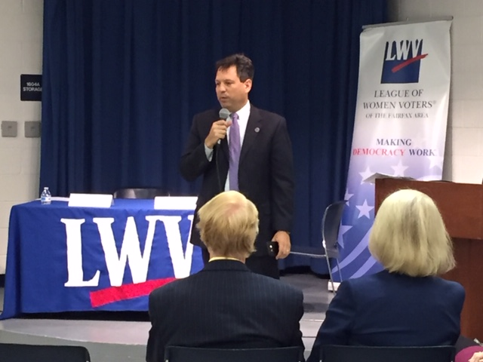
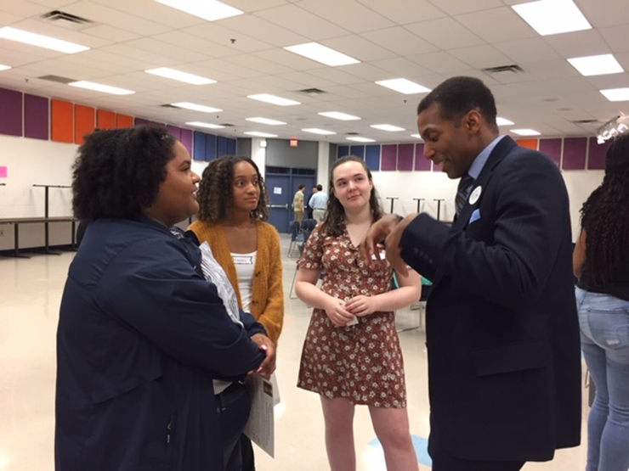
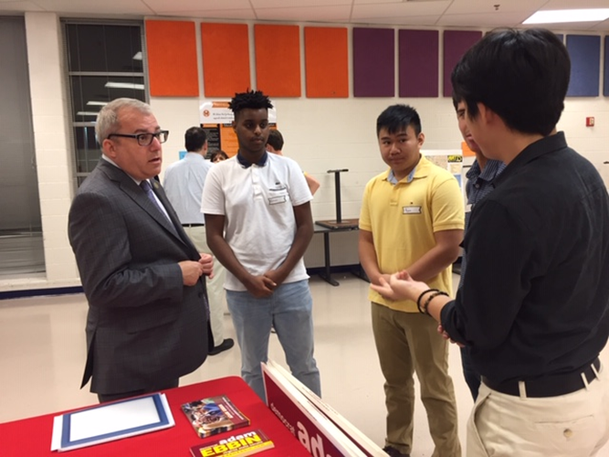
Other Ways to Gather Information
Presidential Debates
Notes:
There are other ways to learn about the candidates as well. You can listen directly to them. Every four years, the presidential debates are held, and you can hear the candidates answer questions in real time. Many campaign appearances include scripted speeches, but the debates require the candidates to think on their feet and answer questions that are NOT given to them in advance. You will see how candidates respond under pressure.
For local and state elections, in-person candidate forums are held. Candidates answer the same questions, so you can learn their point of view. They do not know the questions ahead of time. The audience is also allowed to ask questions of the candidates.
Particularly for local and state elections, look for ways to meet the candidates in person and ask them questions about issues that are important to you. Candidates often seek out opportunities to meet with voters such as fairs or festivals. Sometimes, the candidate will even appear on your doorstep to meet you!
Images:
http://www.clipartpanda.com/clipart_images/speech-and-debate-clipart-58678051
https://www.freepik.com/free-vector/fourth-july-element-collection_4510082.htm#page=2&query=patriotic+bunting&position=11
Meet the candidates- http://clipart-library.com/clipart/328763.htm
Photos by League of Women Voters of the Fairfax Area

Slide 14
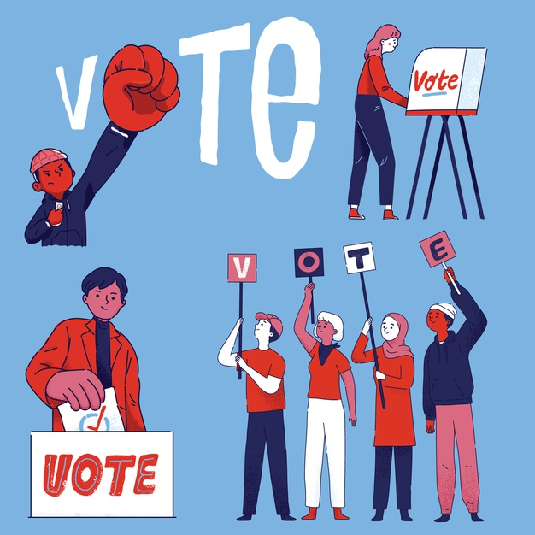
Stop and Think
Check the Source
Be Wary of Slogans
Become a Citizen Investigator
Use what you know, and…
VOTE!
“Every election is determined by the people who show up.”
Larry J. Sabato, University of Virginia
Notes:
Check the facts and keep an open, but critical mind as you make your decisions about candidates running for office. Most likely, there is no one candidate who will check all of the boxes for your desired positions on issues. Then you need to decide which issues are most important to you.
By voting you can influence the government of our country, our state, and our county, but you will have influence only if you show up to vote.
Voting is a a powerful tool; use this powerful tool wisely!
Image:
https://www.freepik.com/free-vector/group-people-citizens-vote-election_10541575.htm#page=1&query=usa%20vote&position=27

