Slide 1
Notes for Teachers
A script to accompany this PowerPoint can be found in the notes section of the presentation and in a separate document.
Use this PowerPoint in advance of an election to give first-time voters an overview of what to expect when they go to the polls.
Encourage students to research candidates and issues on the ballot even if they are not eligible to vote.
Prompt students to explore the various polling places in Fairfax County, including polling places for Early Voting and Election Day Voting. Are these locations easily accessible for people who use public transportation? What accommodations are being provided for disabled or elderly voters?
This presentation could be aligned with additional lessons or research on how in-person voting has been made more accessible or less accessible to voters over the years.
.

Slide 2
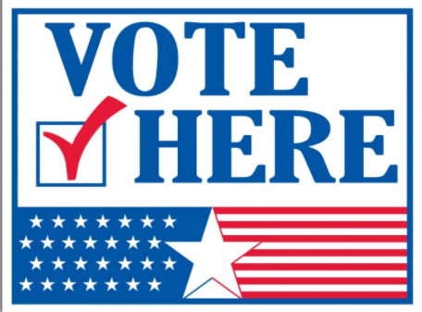
Casting Your Ballot:
In-Person Voting
100 Year Mission To:
Empower Voters
Defend Democracy
Notes:
Welcome to this presentation by the League of Women Voters. Shortly after the 19th amendment was passed and women received the right to vote, the League of Women Voters was established to assist people to register to vote and provide nonpartisan information so that people could become educated voters. In-Person Voting is currently the most used mode of voting. The goal of this PowerPoint is to provide information so that you know what to expect when you go to vote in person and are familiar with what you will encounter when you go a polling place.
Image: http://clipart-library.com/clipart/dT9LXpgT7.htm

Slide 3
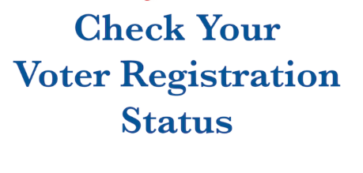
Before You Go to Vote
Are you registered?
Check by going to this website a month before an election.
https://vote.elections.virginia.gov/VoterInformation
You can update your address, if needed.
Notes:
Before you go to vote, check to make sure that you are registered because you must be registered in order to vote. Check your registration about a month ahead of an election. You can do this online by clicking on the address in the slide or typing https://vote.elections.virginia.gov/VoterInformation in the search box on your computer.
Then if you need to update your address, you will have time to do it. If you receive a notice about your registration from the Office of Elections, be sure to read it and reply.

Slide 4
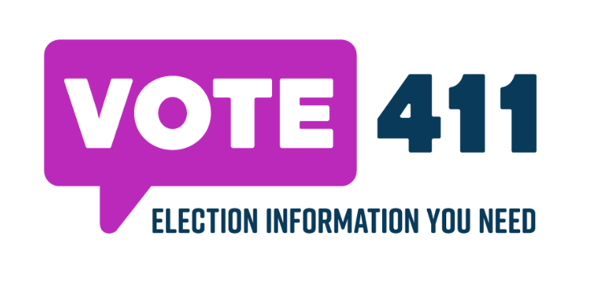
Before You Go to Vote
Are you informed?
Which candidates will get your vote?
What issues are on the ballot?
What do you know about these issues?
How are you going to vote on these issues?
https://www.vote411.org/
Notes:
You need information so that you are prepared to make good decisions about candidates and issues that are on the ballot. Go to Vote411.org (https://www.vote411.org/ ) to learn about the candidates and the issues that will be on your specific ballot. Think about your values and your views. Decide which candidate most supports your views and will do a good job representing you. Understand the issues that are on the ballot. Learn more about both sides of these issues and make an informed decision ahead of time. You can print a sample ballot from this website and take it with you to the polling place, if you wish.

Slide 5
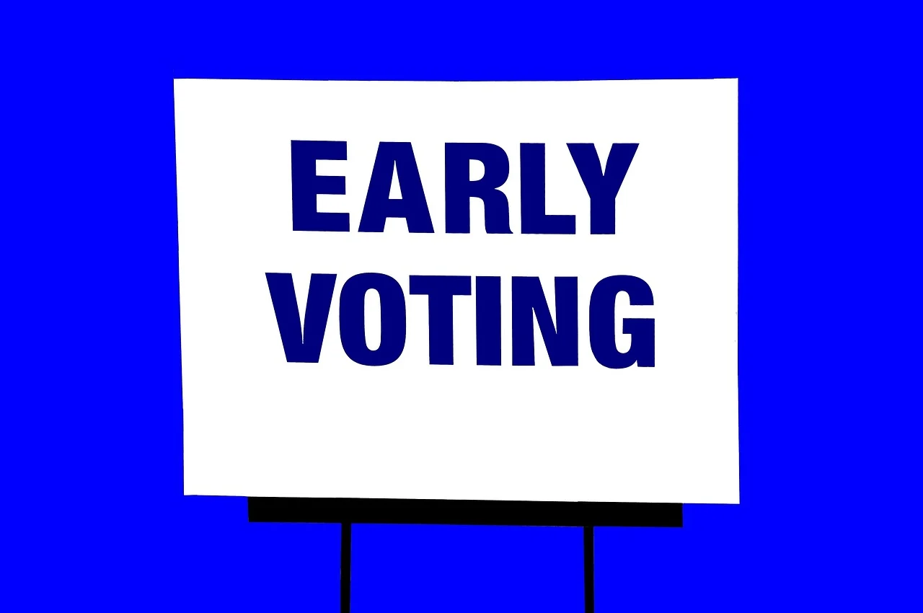
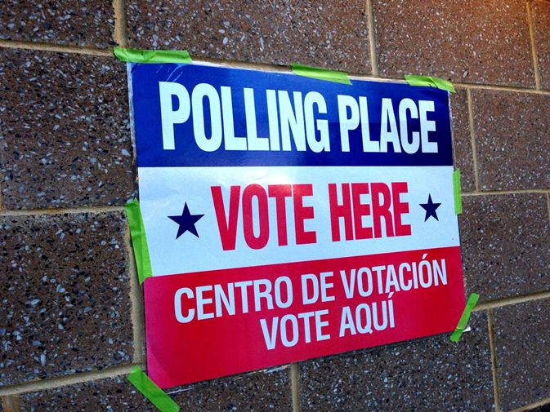
Before You Go to Vote
Do you know when and where to vote?
Early Voting
(In-Person Absentee)
Voting on Election Day
(At Your Polling Place)
OR
Notes:
There are two ways to vote in person. Early Voting and Voting on Election Day. Let’s look at each of them.
Images:
https://pixabay.com/photos/early-voting-sign-2328912/
"Polling Place - Vote Here" by Mrs. Gemstone is licensed under CC BY-SA 2.0

Slide 6
Early Voting (In-Person Absentee Voting)
In Virginia, you can vote 45 days before election day.
You do NOT need:
A reason to vote early.
An absentee ballot.
Look for the early voting locations, dates, and times for your county or city on their website.
The Saturday before Election Day is the last day for early voting.
Notes:
In Virginia, you can vote 45 days before election day. This Early Voting is also called In-Person Absentee Voting because people are voting in person, but they are absent from voting on election day. To vote early, you do NOT need a specific reason, and you do NOT need to request an absentee ballot. The specific locations and times for early voting differ across Virginia. In Fairfax County one location is usually in the Fairfax County Government Center. To find additional locations, dates, and times when you could vote early, go to the website of your county or city Office of Elections. This information might be also posted online. If you are a registered voter, you can vote at any Early Voting location provided by your county or city.
Image:
https://pixabay.com/photos/early-voting-sign-2328912/

Slide 7
Voting on Election Day
You can vote in-person on Election Day. The specific date changes each year.
The polls are open from 6 a.m. to
7 p.m. in 2020. You must be in line by 7 p.m. to vote.
You must vote at your assigned polling place.
Check the location by going to this website.
https://Vote.Elections.Virginia.Gov
Notes:
Election Day is the same day across the United States. It is always on the first Tuesday after the first Monday in November. That’s why the specific date changes from year to year. This year in Virginia, the polls will be open from 6 in the morning to 7 in the evening. As long as you are in line by 7 p.m., you will be allowed to vote no matter how long the line is at 7 pm. You must vote in your assigned polling place. That location is listed on the notification you received with confirmation of your registration. You can also find it by clicking on the link on the slide or type https://vote.elections.virginia.gov/VoterInformation in the search box.
Image:
"Polling Place" by edenpictures is licensed under CC BY 2.0

Slide 8
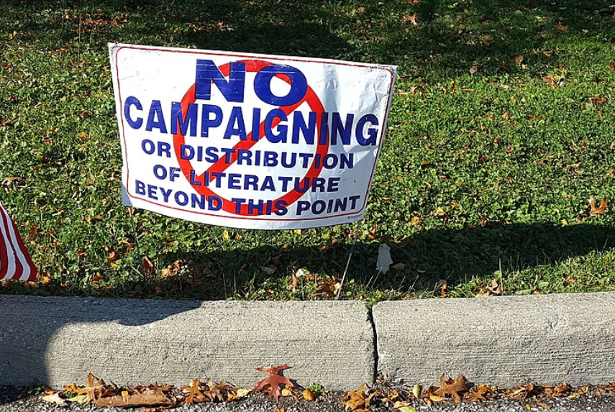
Outside the Polling Location
Notes:
When you arrive at a polling place, there probably will be signs around the outside of the building. People may also be distributing campaign materials. This is one last attempt to influence your vote.
By law, signs and people distributing campaign literature must stay 40 feet away from the entrance. You can accept the handouts or not. You can talk to them or not.
Images:
File:Campaign supporters with candidate placards..JPG - Wikimedia Commons
File:No campaigning sign (49155611557).jpg - Wikimedia Commons

Slide 9
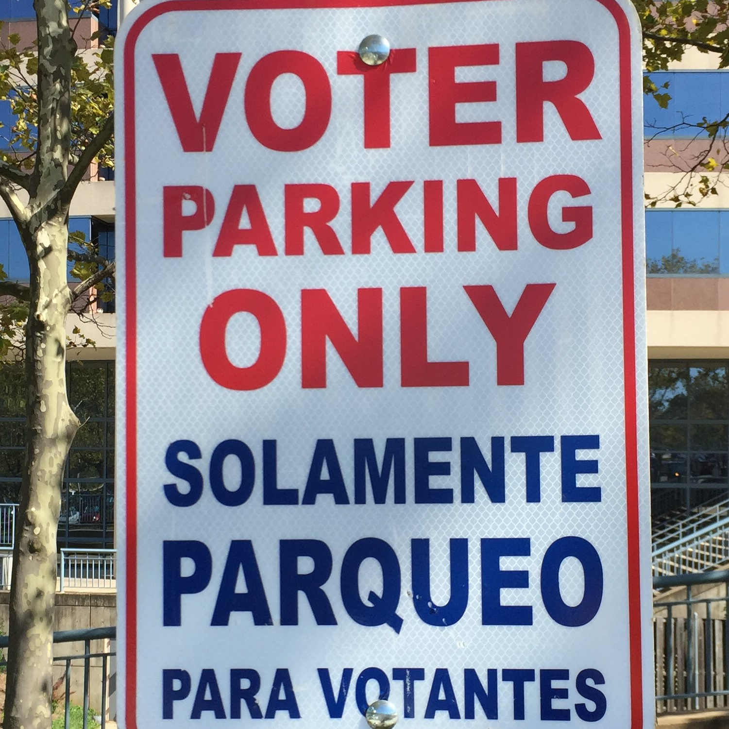
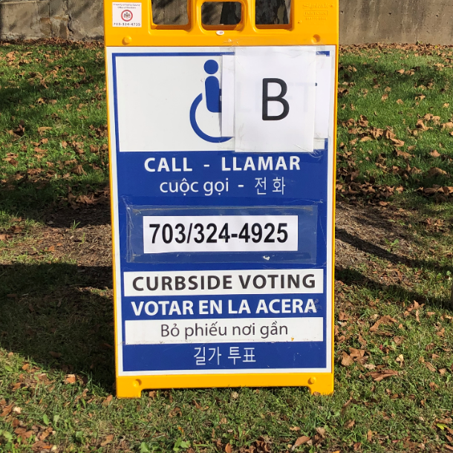
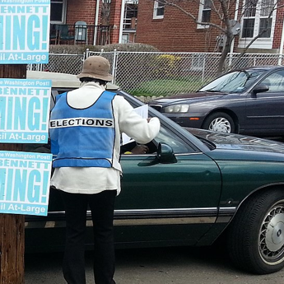
Reserved Parking
Equal Access for
People with Disabilities
Notes:
Parking spaces are often reserved for voters. In addition, special parking places are available for disabled people and sometimes for elderly people. Additionally, if people are handicapped and cannot walk into the polling station, there should be a sign with a phone number so that someone from the polling station will come out to the car with a ballot. This ensures equal access for ALL to vote.
Images:
League of Women Voters of the Fairfax Area, taken by Beth Tudan
League of Women Voters of the Fairfax Area, taken by Beth Tudan
https://commons.wikimedia.org/wiki/File:Curbside_voting_-_Anacostia_library_-_2014-04-01_(13567200214).jpg

Slide 10
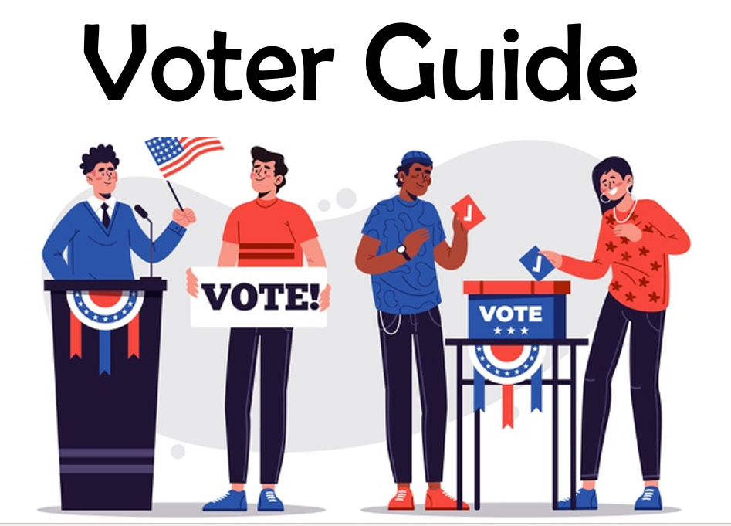
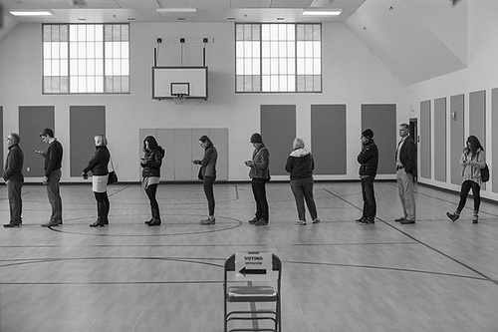
Inside the Polling Location
Follow the signs to the voting area
inside the building.
You can:
Take reference materials needed for your vote, such as a Voter Guide.
Wear something, such as a political button or cap, that supports your candidate or issue.
You cannot campaign inside the building where the polling place is located.
Notes:
Once inside, follow the signs directing you to the polling place location in that building. You can take written material with you that will help you to vote. You can also wear a sticker, button, shirt, hat, or other apparel with a candidate's name or a political slogan on it. However, you can NOT campaign or try to influence other voters inside a polling place.
Images:
<a href="https://www.freepik.com/vectors/usa">Usa vector created by freepik - www.freepik.com</a>
Words added
"Polling place" by BWJones is licensed under CC BY-NC-ND 2.0

Slide 11
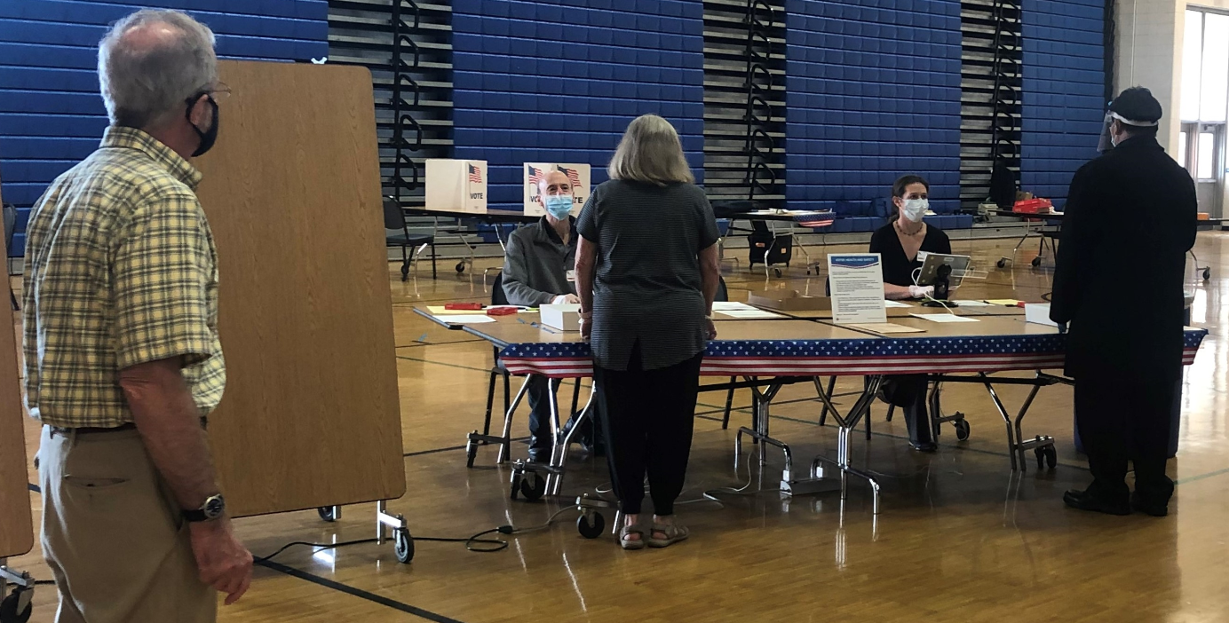
Sign in with Election Officials
Provide an acceptable ID.
A list is on the next slide.
(If you forget your ID, you will receive
a provisional ballot.)
State your name and address.
Receive a paper ballot.
Notes:
Election officials will be sitting at a table. There may be other people behind them or on the side, as well. These people are “election observers” or “poll watchers” who are there to ensure that the required procedures are being followed correctly.
The election officials will ask you for an ID. You must show proof of your identity. Many documents can be used including a driver’s license, a voter registration verification that you received in the mail, or a student ID issued in the United States. Look at the next slide to view all the acceptable documents that can be used for voter identification. If you forget to bring an ID, you will be given a provisional ballot. You will be able to vote with this ballot, but it will not be counted until you bring acceptable ID to the Electoral Board within a designated time.
You will be asked to state your name and address and this information will be checked against official voter registration records. You will receive a paper ballot or be directed where to go to get one.
Image: League of Women Voters of the Fairfax Area, photo by Beth Tudan

Slide 12
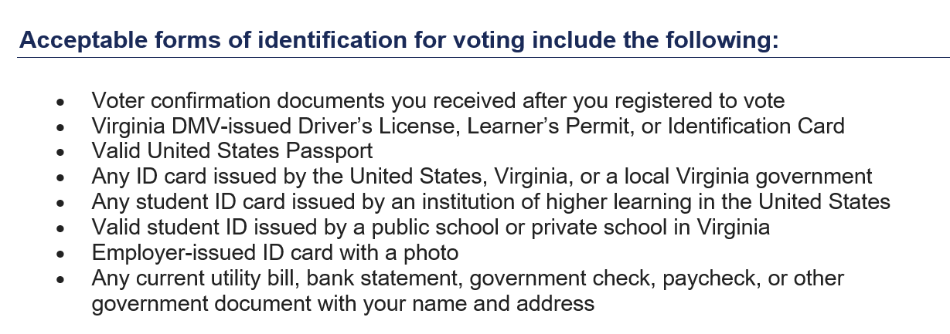
Notes:
This is a list of acceptable forms of identification for voting. Remember to being an ID with you when you vote.
Note: For the latest information about voting in Virginia go to this site: https://www.elections.virginia.gov/casting-a-ballot/

Slide 13
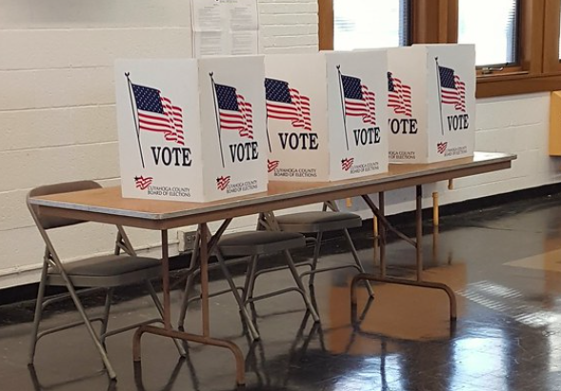
Mark your ballot in private. Use a blue or black ballpoint pen.
Notes:
The election officials may give you a pen or you can use one that you brought. You cannot use pencil or a gel pen. It must be a blue or black ballpoint pen.
Take your ballot to the table as directed to vote in private. The ballot might be two-sided, so look at both sides to ensure that you are voting on everything.
Your secret ballot does not need to be shared with anyone. That’s why you may get a file folder to hold your ballot when you are finished marking it. Be sure to check your ballot to make sure it is completed as appropriate before proceeding to the next station.
Image:
"Voting booths in Cleveland Heights" by Tim Evanson is licensed under CC BY-SA 2.0

Slide 14
Notes:
Completely fill in the oval next to your choice. Do not make other marks on the ballot. Make sure you vote for only the correct number of candidates.
Image: Free image from SnappyGoat.com
https://www.google.com/imgres?imgurl=https%3A%2F%2Fsnappygoat.com%2Fb%2Fd33412efb69aac7fd415e69682035b5481feb9b4&imgrefurl=https%3A%2F%2Fsnappygoat.com%2Fs%2F%3Fq%3Dvote&tbnid=oei-D894nPFNbM&vet=10CHwQMyiNAWoXChMI0Mjm66LR7QIVAAAAAB0AAAAAEAo..i&docid=4c_X3CCGXURK0M&w=725&h=512&safe=images&ved=0CHwQMyiNAWoXChMI0Mjm66LR7QIVAAAAAB0AAAAAEAo

Slide 15
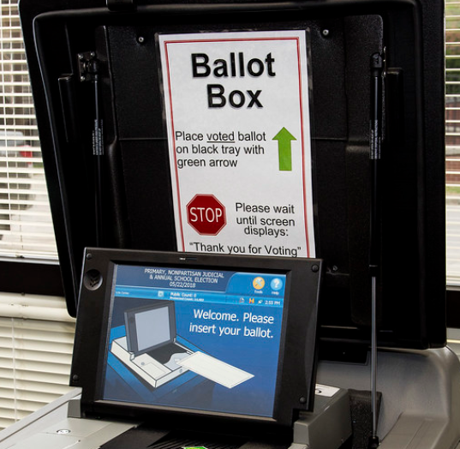
Scan Your Paper Ballot
Notes:
After you have marked your choices on the ballot, put it in the folder, and go to the election official by the scanning machine. You will be directed to insert your paper ballot into the machine which will scan it and keep it for the records in case there is a need for a recount of votes. You do not need to show how you voted to anyone.
Image:
"Voting Machines and Equipment" by uacescomm is licensed under CC BY-NC-SA 2.0

Slide 16
Congratulations! Your ballot will be counted.
Notes:
Congratulations! You have voted, and your voice will be heard. Remember, every vote counts!
"Your Vote Counts!" by The COM Library is licensed under CC BY-NC-ND 2.0

