Slide 1
Notes for Teachers
The topic of the History of Voting Rights has been divided into two PowerPoint presentations due to length and size of files. Part 1 includes 1787 through 1920 and Part 2 includes 1924 to Present Day.
A script to accompany this PowerPoint can be found in the notes section and in a separate Word document.
Consider using this PowerPoint in advance of studying voting rights to expand students’ background knowledge. It also could be used with specific students to reinforce information previously taught.
Encourage students to research:
Barriers to voting after passage of the 15 Amendment.
Progression of women’s suffrage.
Women who served or are serving in the U.S. House of Representatives and/or Senate.
Minority men and/or women who served or are serving in the US House of Representatives and/or the Senate, especially during the Reconstruction Era.
Prompt students to view and discuss the resource, Strategies of Suffrage, Working for Votes for Women, posted on the Educator Resources webpage.
.

Slide 2
Who Can Vote?
A Short History of Voting Rights
1787 – 1920 (Part 1)
100 Year Mission To:
Empower Voters
Defend Democracy
Notes:
Who can participate in government? Who has a voice? Does “We the People” really mean ALL citizens? And who is considered a citizen?
This PowerPoint describes the expansion of voting rights in the United States from 1787 to 1920; however, during this same time, some people’s voting rights continued to be denied.
Image: Question Answer Mark - Free vector graphic on Pixabay

Slide 3
What do you think?
 | True | False
The states make all the voting rules.
The federal government makes all the voting rules.
When the 14th Amendment was passed, it gave equal protection of the law to all people in the United States.
If a person passed a literacy test, that person was able to register and vote.
The 19th Amendment granted voting rights to all women in the United States
Notes:
Take a minute to read these sentences and decide if each one is true or false.
Did you know that all these sentence are false? Listen to the information in this PowerPoint to find out more.

Slide 4
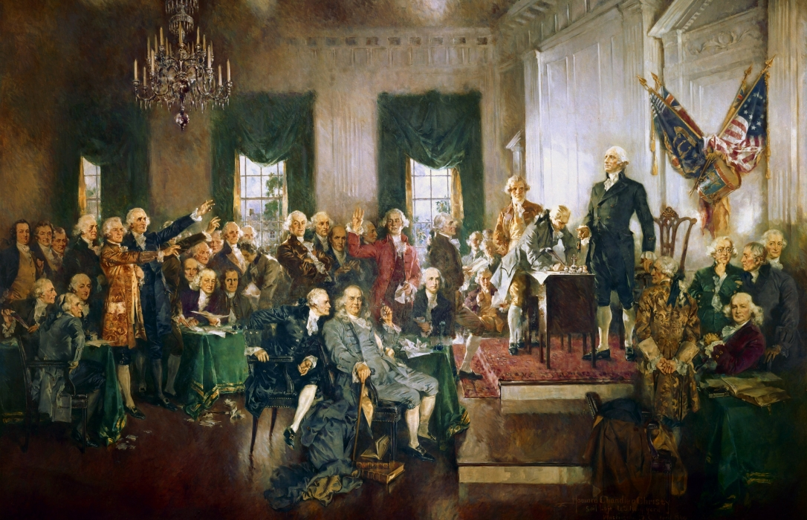
When the U.S. Constitution was adopted in 1787, decisions about voting rights were left to the states.
Notice who could not vote:
Men without land
Women
Slaves
Native Americans
People under 21
Notes:
Even though the U.S. Constitution starts with “We the People . . .”, it did not include ALL people that were in the United States at that time. The creators of the Constitution could not agree on how elections for federal offices would be conducted, so they decided to let the states make their own decisions about voting rights. However, as a safeguard, they added a clause to the Constitution that allowed Congress to make laws about voting or change states’ laws or regulations about voting.
As a result, at first, white men with property were the only Americans routinely permitted to vote. This meant that even some soldiers in the American Revolution, such as Black soldiers and those who were not property owners could not vote! Why do you think that was the case at that time?
Image
Architect of the Capitol (public domain) Artfully Yours, George Washington | Architect of the Capitol (aoc.gov)

Slide 5
Voting Differences Among the States
Religious Restrictions
Freed Men
Women with Property (Widows)
“Public Voting”
Amount of Property
Notes:
As you can imagine, leaving control of elections to the individual states led to many different voting requirements, as well as unfair voting practices. Individual states had different rules about the amount of property needed in order to vote. A few states allowed freed slaves to vote, and New Jersey allowed women to vote if they had the correct amount of property; however, these rights were later removed.
Property was not the only qualification for voting. Some states had voting restrictions based on religion. Maryland was the last state to remove religious restrictions for voting, and states no longer denied eligible voters the right to vote based upon their religion.
Black people, women, Native Americans, non-English speakers, and citizens between the ages of 18 and 21 could not vote at this time. Their fight for the right to vote would last almost 200 years.

Slide 6
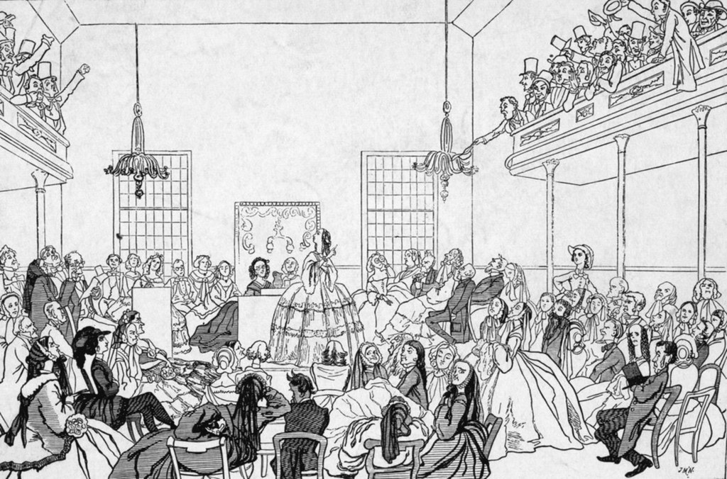
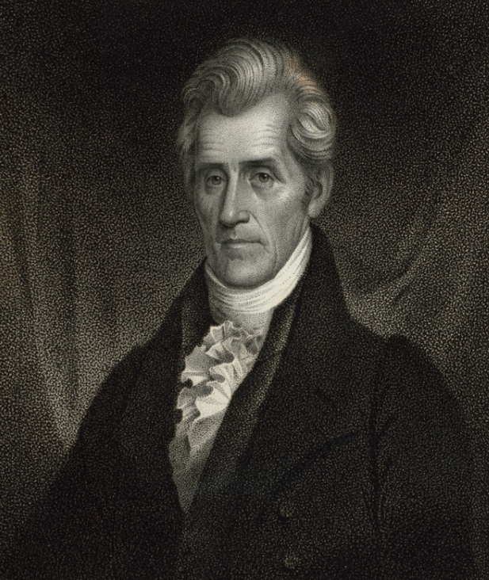
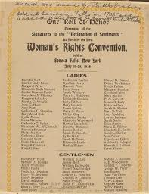
Change starts to come . . .
Seneca Falls Convention, 1848
Election of
Andrew Jackson, 1824
Notes:
President Andrew Jackson was elected in 1824. He was the first president who was not a wealthy landowner from the 13 original colonies. Many western frontiersmen came to the White House to celebrate his inauguration and created an unruly spectacle. Jackson helped advance the political rights of those who did not own property. This opened the political process to include more people, but once again, this only applied to white male citizens. As a result, the 1828 presidential election was the first election in which non-property holding white males could vote in a majority of states.
As the nation expanded and the population increased, the movement for the voice and rights of women to be heard began. A group of women led by Lucretia Mott and Elizabeth Cady Stanton held a conference with about 200 in attendance in 1848 in Seneca Falls, NY. It was advertised as "a convention to discuss the social, civil, and religious condition and rights of woman.“ The conference issued the Declaration of Sentiments and Resolutions which called for equal treatment of men and women under the law and voting rights for women. This was the beginning of the women’s suffrage movement.
Images:
[Andrew Jackson.] - New York Public Library's Public Domain Image (getarchive.net)
File:Jackson inauguration crop.jpg - Wikimedia Commons
"Cartoon of the Seneca Falls Convention" by Varaey is marked with CC PDM 1.0
File:Woman's Rights Convention.jpg - Wikimedia Commons

Slide 7
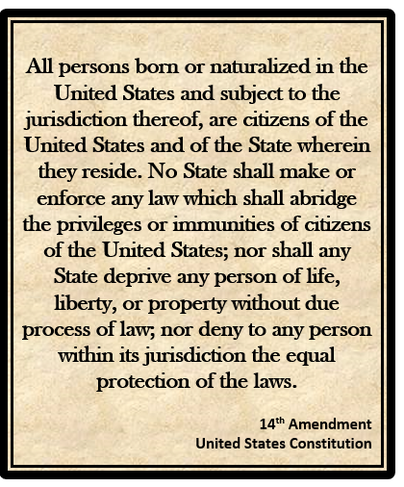
The 14th Amendment (1868) gave equal protection of the law to all U.S. citizens.
Notes:
In 1866 after the Civil War, the 14th Amendment was passed which granted equal protection of laws to all people born in the U.S. or who become naturalized citizens, effectively finally making Black people citizens of the U.S.. This amendment set the stage for the expansion of voting rights. However, Native Americans born on tribal land or reservations were excluded because they were not considered US citizens at this time.
Image: League of Women Voters of the Fairfax Area, created with Microsoft Word

Slide 8
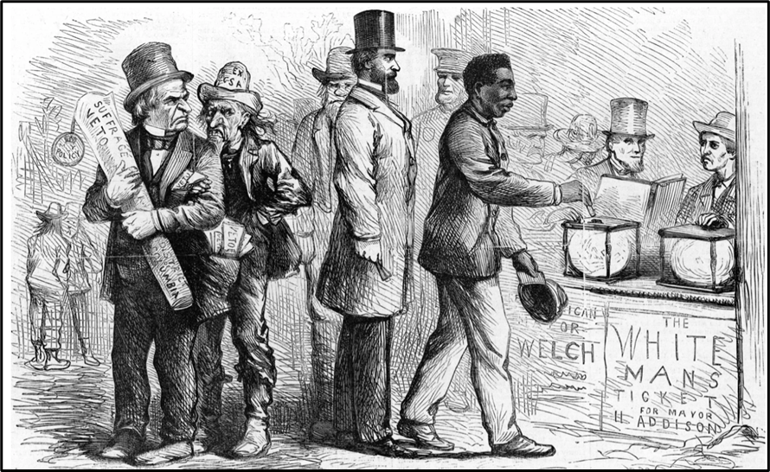
The 15th Amendment (1870) protected the voting rights of male U.S. citizens (regardless of race, color, or previous condition of servitude).
Notes:
In 1870, 15th Amendment extended the right to vote to all male citizens regardless of race, color, or previous enslavement. With the right to vote, many Black men were elected to government positions at all levels of government, national, state, and local. Historians have identified more than 1,500 African Americans officeholders during the Reconstruction Era. However, with the end of the Reconstruction Era in 1876, voting rights for Black people were increasingly suppressed with the passage of various Jim Crow Laws, especially in the South. Note that women were not included in this Amendment and were not allowed to vote as a result.
Image:
http://www.masshist.org/database/images31/7477_georgetown_ref.jpg Massachusetts Historical Society: Image Permissions (masshist.org)

Slide 9
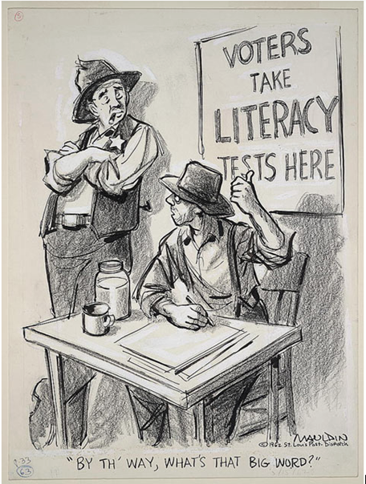
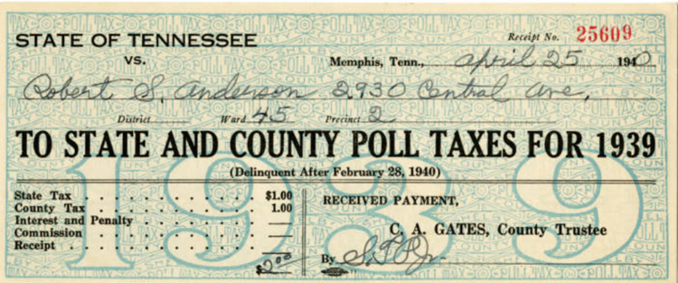
How were voting rights denied?
Poll Taxes
Literacy Tests
Notes:
After Reconstruction ended in 1876, some states enacted laws to restrict the right to vote. These included poll taxes that required people to pay a tax in order to vote. While the amounts of money on these poll taxes do not seem like a lot of money today, in those days, these amounts were significant.
Faced with a choice between putting food on the table or paying to vote, what would you do? Many poor people could not afford to pay the poll tax and therefore could not vote.
There were many versions of literacy tests. All were very difficult and unfair. Especially in smaller towns, the voting registrar decided what would be included on a literacy test and whether a person passed it. Even if all the answers were correct, a person could be judged by the local registrar to have failed the test and not be able to register to vote.
Record Poll Tax Receipt, 1935 | Collections Search Center, Smithsonian Institution (si.edu
sevi033_01 - Looking Back: The Civil War in Tennessee - Tennessee Virtual Archive (oclc.org)
Mauldin, Bill, Artist. "By th' way, what's that big word?". , 1962. [publication date] Photograph. https://www.loc.gov/item/2016687152/.

Slide 10
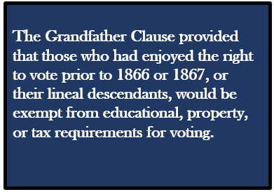
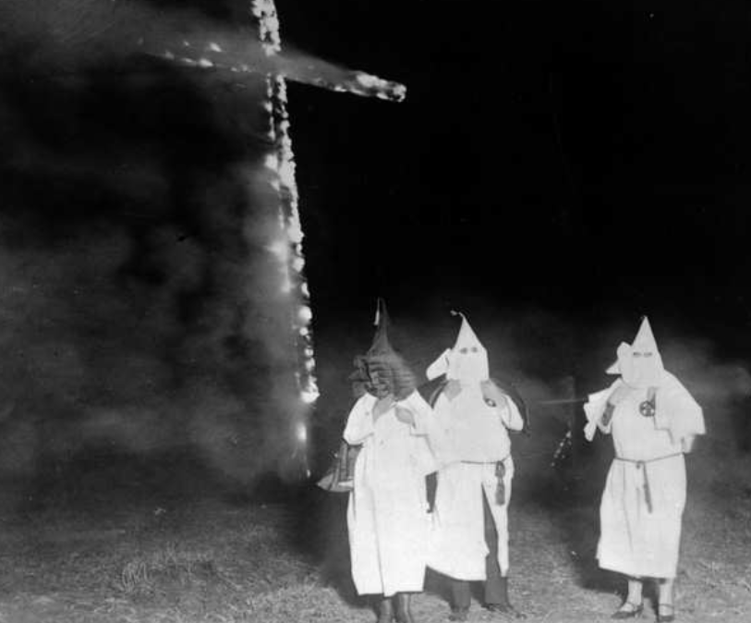
Intimidation and Violence
Grandfather
Clause
If your grandfather could not vote, you could not vote.
Notes:
Some states used the “grandfather clause” to restrict Blacks for voting. This meant that in order to vote, the person’s grandfather had to have been a registered voter. This eliminated anyone freed as a result of the Civil War whose grandfather would have been enslaved. In addition, acts of violence and threats from people and organizations, such as the Ku Klux Klan also intimidated and stopped Black men from registering and voting.
Images:
League of Women Voters of the Fairfax Area, created by Microsoft Word
File:Ku Klux Klan members and a burning cross, Denver, Colorado, 1921.jpg - Wikimedia Commons

Slide 11
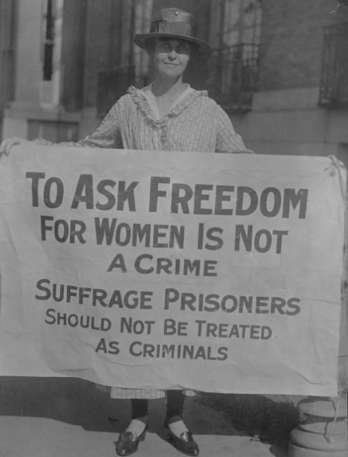
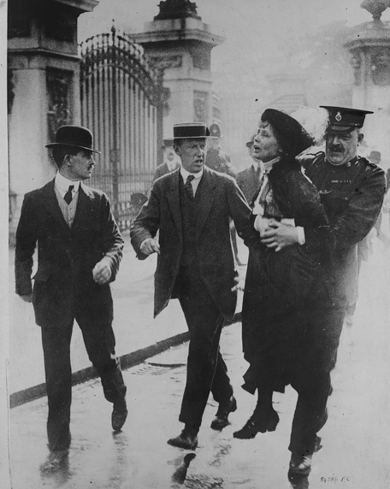
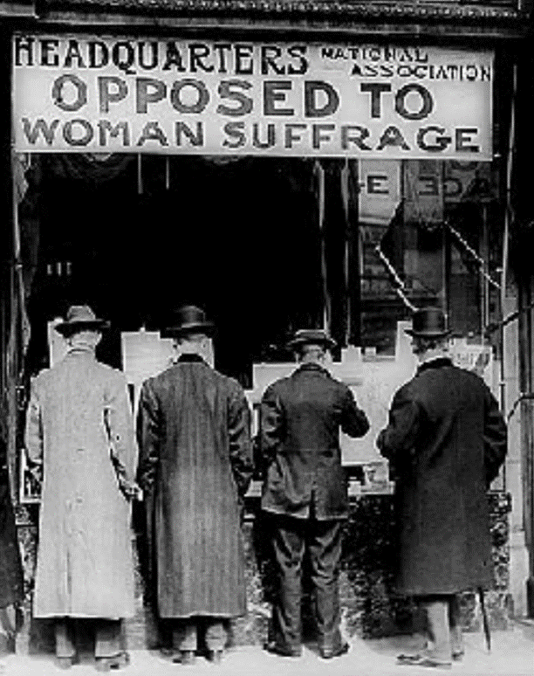
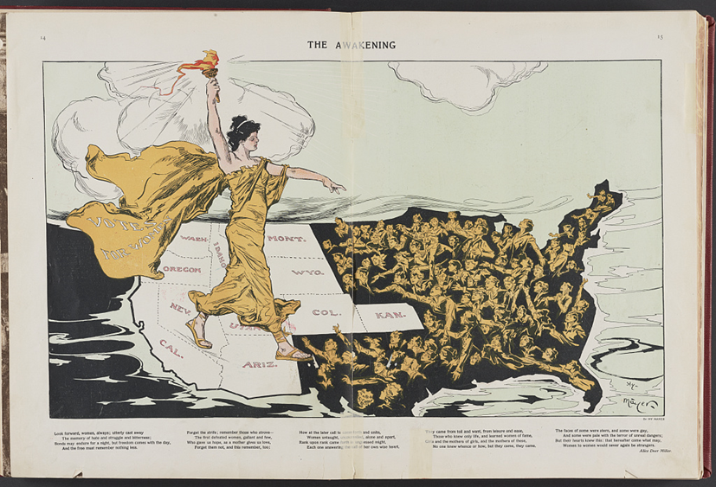
Women Could Not Vote
Notes:
Women organized, marched, demonstrated, debated, lobbied, wrote newspaper articles, and worked hard for the right to vote for years after the Seneca Falls Conference. In 1869, Wyoming became the first state to give women this right. Eight western states followed Wyoming’s example. Why do you think women were given the right to vote in western states first?
But the right to vote was not easily granted by other states. Women continued to advocate for the right to vote nation-wide. The most famous demonstrations took place in front of the White House. Women were arrested for these demonstrations, put in jail, many of them in 1917 at the Occoquan Prison in Lorton, VA (now the Lucy Burns Museum at the Workhouse Art Center) where they were shackled to the wall, and endured abuse. When they went on hunger strikes, they were painfully force-fed with tubes rammed up their noses.
Images:
Harris & Ewing, photographer. National Anti-Suffrage Association. , 1911. [?] Photograph. https://www.loc.gov/item/97500067/.
Harris & Ewing, Washington, D.C. Mary Winsor Penn. '17 holding Suffrage Prisoners banner. United States Washington D.C, 1917. [Oct.-Nov] Photograph. https://www.loc.gov/item/mnwp000225/.
Harris & Ewing, photographer. National Anti-Suffrage Association. , 1911. [?] Photograph. https://www.loc.gov/item/97500067/.
Mayer, Henry, Artist. The awakening / Hy Mayer. United States, 1915. New York: Published by Puck Publishing Corporation, 295-309 Lafayette Street. Photograph. https://www.loc.gov/item/98502844/.

Slide 12
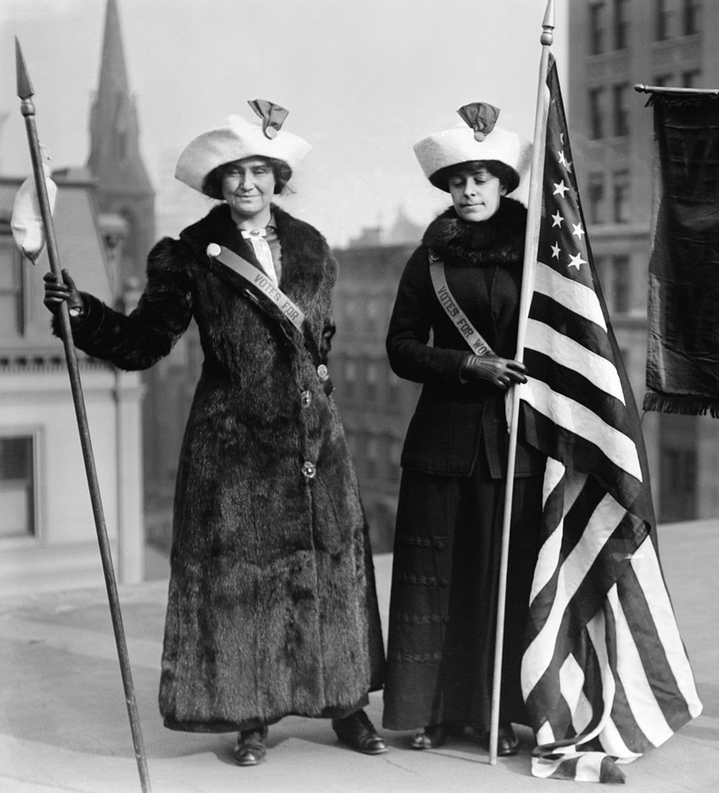
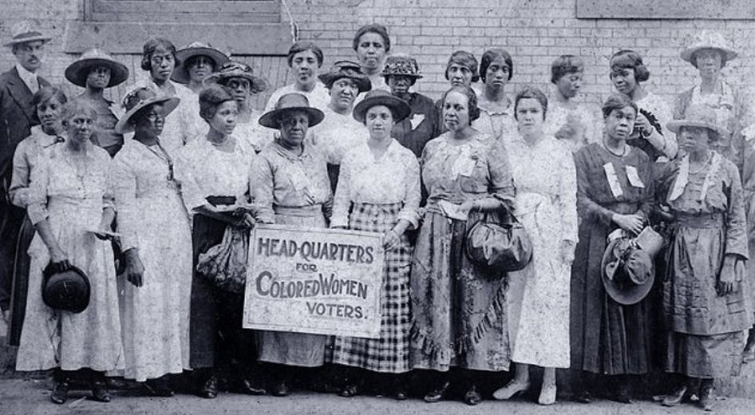
The 19th Amendment (1920) granted women citizens the right to vote.
For many, using that right was still a struggle!
The right of citizens of the United States to vote shall not be denied or abridged by the United States or by any State on account of sex.
Notes:
While Congress finally approved legislation allowing women to vote in May 1919, it would take more than a year before the Amendment was approved by the states to become law. Women finally won the right to vote when Tennessee approved the 19th Amendment by ONE vote! Although women won the right to vote in 1920 with the 19th Amendment, Black women faced the same obstacles as Black men. Jim Crow laws suppressed their voting rights. It would be many more decades before most Black women would be able to cast a ballot. Since Native Americans and Asian Americans were not considered citizens in 1920, the 19th Amendment did not apply to these women either until decades later.
Images:
File:The Library of Congress - (Suffragettes with flag) (LOC).jpg - Wikimedia Commons
Schomburg Center for Research in Black Culture, Photographs and Prints Division, The New York Public Library. "Black women suffragists holding sign reading "Head-Quarters for Colored Women Voters," in Georgia" The New York Public Library Digital Collections. 1910 - 1920. https://digitalcollections.nypl.org/items/09740960-d940-0136-3dde-3d48f083c992

Slide 13
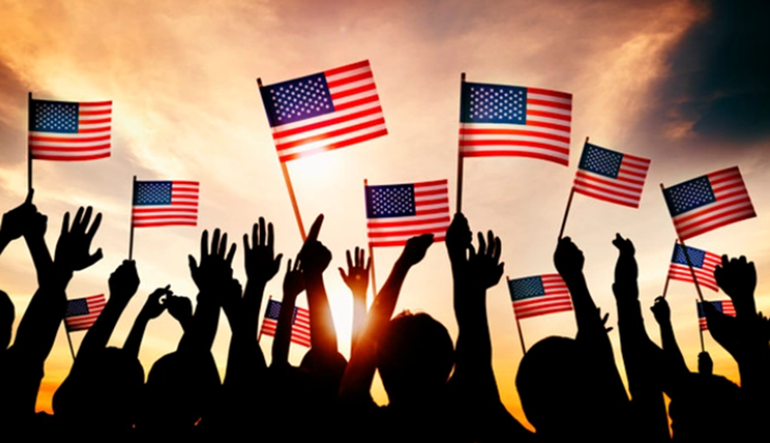
Who Could NOT Vote in 1920?
Black men and women, although technically they had the right to vote
Native Americans
Asian Americans
People under 21
More
Change Is
Needed!
Notes:
While more citizens were able to vote in 1920, more change was needed. Although Black men and women had the right to vote, this right was suppressed in many states. Native Americans, Asian Americans, and people under age 21 still could not vote. For the rest of the story, see Part 2 of the presentation, Who Can Vote? A Short History of Voting Rights, Part. 2.
Image:
https://www.freepik.com/free-photo/group-people-waving-american-flags-back-lit_3533286.htm#page=5&query=united+states&position=41

